Slide 1


Relativistic corrections to exclusive photoproduction of quarkonia near-threshold
Sarah K. Blask
University of Arizona | Quark-Gluon Tomography (QGT) Collaboration
In collaboration with
Sean Fleming (Arizona) & Jyotirmoy Roy (Duke), Iain Stewart (MIT)
XXIII Annual Workshop on Soft-Collinear Effective Theory at KIAS
5th March 2026

Slide 2
Overview
Motivation
NRQCD Framework
Generalized Parton Distributions (GPDs)
Amplitude
Introduction of GPD into calculation
Hard matching coefficient
Photoproduction cross section
Conclusions
Notes:
2. Assuming suppressed contributions from the intrinsic heavy quarks

Slide 3
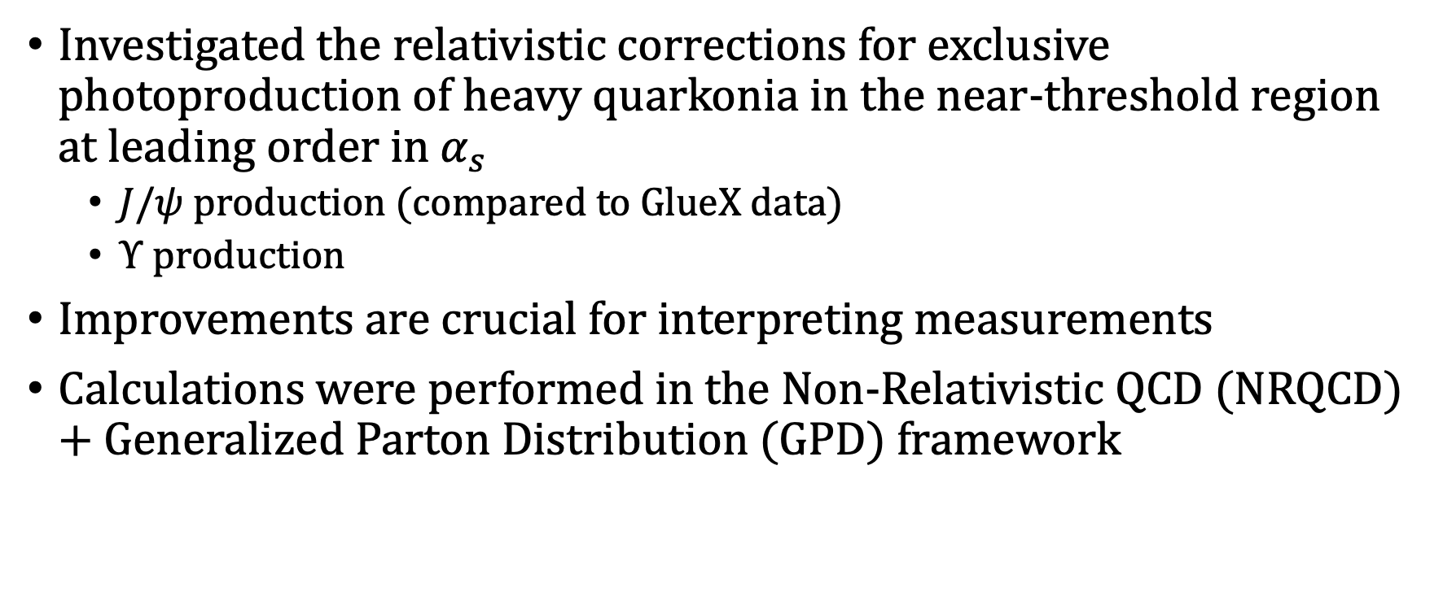
Photoproduction of heavy quarkonium near-threshold
Investigated the relativistic corrections for exclusive photoproduction of heavy quarkonia in the near-threshold region at leading order in $α_{s}$
$J/ψ$ production (compared to GlueX data)
$Υ$ production
Improvements are crucial for interpreting measurements
Calculations were performed in the Non-Relativistic QCD (NRQCD) + Generalized Parton Distribution (GPD) framework
[S.K. Blask, S. Fleming, T. Mehen, J. Roy, I.W. Stewart and F. Zhao, Relativistic corrections
to exclusive photoproduction of Quarkonia near-threshold, 2506.18905.]
Notes:
In the following presentation, I will discuss the results of our recent publication where we performed these calculations in the NRQCD+GPD framework

Slide 4
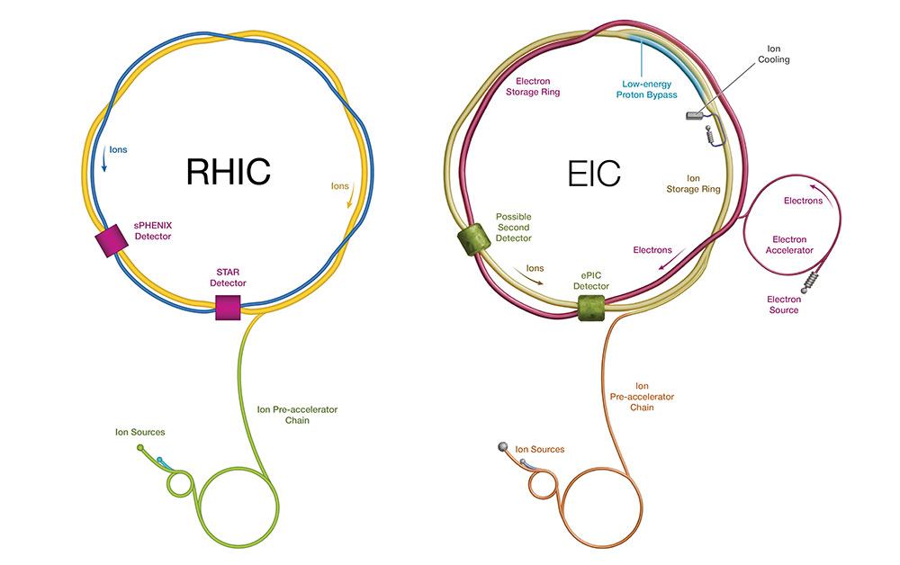
Photoproduction of heavy quarkonium near-threshold
Increasing interest in studying the exclusive electro/photo-productions of heavy quarkonium
Electron-Ion Collider (EIC) planned for construction at Brookhaven Lab
Notes:
2. Assuming suppressed contributions from the intrinsic heavy quarks
*EIC: adding electron source, electron accelerator ring, and electron storage ring

Slide 5
Photoproduction of heavy quarkonium near-threshold
Exclusive quarkonium production near-threshold is a key probe in understanding gluon structure
Dominated by gluon exchange = information about gluonic structure
In the near-threshold limit, amplitude can be factorized with gluon GPDs at leading order ^{[2]}
Is directly related to the gluonic gravitational form factors (GFFs) of the proton – encodes information about pressure, energy, and distributions of gluons in the proton
[2] [Y. Guo, X. Ji and Y. Liu, QCD Analysis of Near-Threshold Photon-Proton Production of
Heavy Quarkonium, Phys. Rev. D 103 (2021) 096010 [2103.11506].]
Notes:
2. Assuming suppressed contributions from the intrinsic heavy quarks

Slide 6
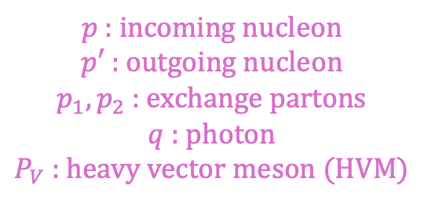
NRQCD Framework
Exclusive photoproduction of quarkonium is mediated via two-parton exchange, where the incoming nucleon recoils with a different momentum instead of breaking apart like in deep inelastic scattering
The production of the quark-antiquark pair + its recombination into a heavy vector meson (HVM) state can be calculated in the nonrelativistic QCD (NRQCD) framework
$p$ : incoming nucleon
$p′$ : outgoing nucleon
$p_{1}, p_{2}$ : exchange partons
$q$ : photon
$P_{V}$ : heavy vector meson (HVM)

Slide 7
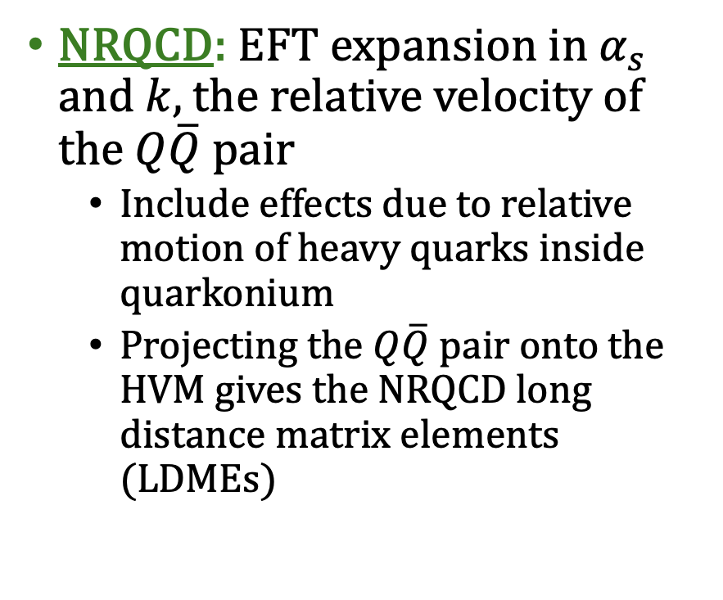
NRQCD Framework
NRQCD: EFT expansion in $α_{s}$ and $k$, the relative velocity of the $Q\overline{Q}$pair
Include effects due to relative motion of heavy quarks inside quarkonium
Projecting the $Q\overline{Q}$ pair onto the HVM gives the NRQCD long distance matrix elements (LDMEs)
$p$ : incoming nucleon
$p′$ : outgoing nucleon
$p_{1}, p_{2}$ : exchange partons
$q$ : photon
$P_{V}$ : heavy vector meson (HVM)
Notes:
**explain that we will expand k to get relativistic corrections

Slide 8
NRQCD Framework
Using NRQCD and collinear expansion, amplitude can be factorized into:
Short-distance hard matching coefficient
Long-distance matrix element (LDME)
Gluon GPD
$$ℳ\sim C\left(x,ξ\right)\left\langle 0\left|𝒪\left(3S_{1}\right)\right|V\right\rangle ⨂G(x,ξ,t)$$
Notes:
**explain that we will expand v to get relativistic corrections
- Gluon GPD parametrizes the dynamics of gluons in the recoiling proton at the nonperturbative scale.

Slide 9
NRQCD Framework
Using NRQCD and collinear expansion, amplitude can be factorized into:
Short-distance hard matching coefficient
NRQCD long-distance matrix element (LDME)
Gluon GPD
$$ℳ\sim C\left(x,ξ\right)\left\langle 0\left|𝒪\left(3S_{1}\right)\right|V\right\rangle ⨂G(x,ξ,t)$$
Notes:
**explain that we will expand v to get relativistic corrections
- Gluon GPD parametrizes the dynamics of gluons in the recoiling proton at the nonperturbative scale.

Slide 10
NRQCD Framework
Using NRQCD and collinear expansion, amplitude can be factorized into:
Short-distance hard matching coefficient
NRQCD long-distance matrix element (LDME)
Gluon GPD
$$ℳ\sim C\left(x,ξ\right)\left\langle 0\left|𝒪\left(3S_{1}\right)\right|V\right\rangle ⨂G(x,ξ,t)$$
Notes:
- LDME is related to the quarkonium wavefunction at the origin
- Gluon GPD parametrizes the dynamics of gluons in the recoiling proton at the nonperturbative scale.

Slide 11
NRQCD Framework
Using NRQCD and collinear expansion, amplitude can be factorized into:
Short-distance hard matching coefficient
NRQCD long-distance matrix element (LDME)
Gluon GPD
$$ℳ\sim C\left(x,ξ\right)\left\langle 0\left|𝒪\left(3S_{1}\right)\right|V\right\rangle ⨂G(x,ξ,t)$$
Notes:
**explain that we will expand v to get relativistic corrections
- Gluon GPD parametrizes the dynamics of gluons in the recoiling proton at the nonperturbative scale.

Slide 12
Generalized Parton Distributions (GPDs)
Generalized Parton Distributions (GPDs): nonperturbative quantities that describe the correlated distribution of partons in momentum and position space
Form factors
Parton distribution functions
Information about spin & angular momentum
Notes:
M. Diehl, Generalized Parton Distributions, Phys. Rept. 388 (2003)

Slide 13
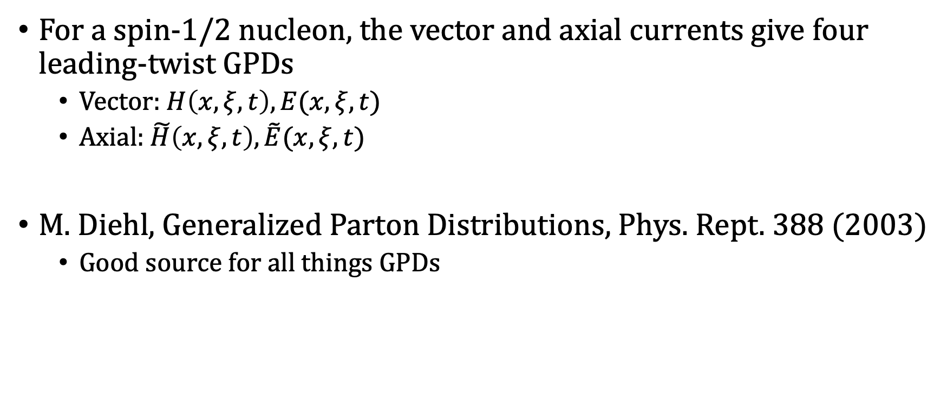
Generalized Parton Distributions (GPDs)
For a spin-1/2 nucleon, the vector and axial currents give four leading-twist GPDs
Vector: $H\left(x,ξ,t\right), E(x,ξ,t)$
Axial: $\tilde{H}\left(x,ξ,t\right), \tilde{E}(x,ξ,t)$
M. Diehl, Generalized Parton Distributions, Phys. Rept. 388 (2003)
Good source for all things GPDs
Parameterize the nonperturbative nucleon structure
Notes:
M. Diehl, Generalized Parton Distributions, Phys. Rept. 388 (2003)

Slide 14

Amplitude
At leading order in $α_{s}$, the on-shell heavy quark-antiquark pair is produced via two-gluon exchange

Slide 15
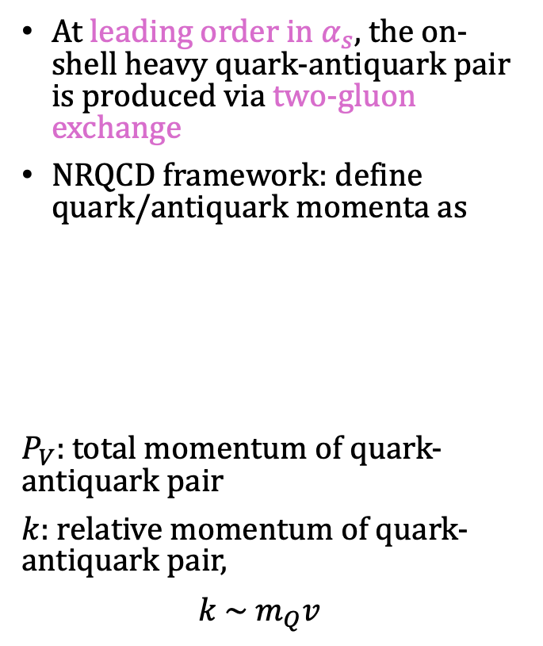
Amplitude
At leading order in $α_{s}$, the on-shell heavy quark-antiquark pair is produced via two-gluon exchange
NRQCD framework: define quark/antiquark momenta as
$P_{V}$: total momentum of quark-antiquark pair
$k$: relative momentum of quark-antiquark pair,
$k \sim m_{Q}v$

Slide 16
Amplitude
General expression for amplitude:
Notes:
Lorentz indices that contract with the gluon polarization vectors are given in parentheses later
A is a matrix that acts on both Dirac and color indices

Slide 17
Amplitude
Polarization vectors for incoming/outgoing gluons (will be important later!)
General expression for amplitude:
Notes:
Lorentz indices that contract with the gluon polarization vectors are given in parentheses later
A is a matrix that acts on both Dirac and color indices

Slide 18

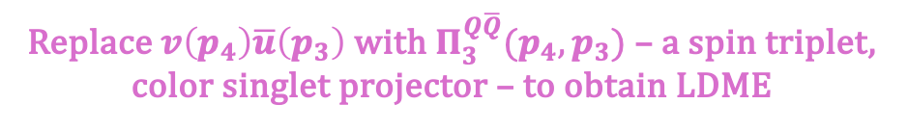
Amplitude
Polarization vectors for incoming/outgoing gluons (will be important later!)
General expression for amplitude:
$$N_{C}=3$$
$ε_{V}^{∗}$: quarkonium spin polarization vector,
$$ε_{V}^{∗}⋅ε_{V}=−1$$
$$P_{V}⋅ε_{V}=0$$
Replace $v\left(p_{4}\right)\overline{u}\left(p_{3}\right)$ with $Π_{3}^{Q\overline{Q}}(p_{4},p_{3})$ – a spin triplet, color singlet projector – to obtain LDME
Notes:
Lorentz indices that contract with the gluon polarization vectors are given in parentheses later
A is a matrix that acts on both Dirac and color indices

Slide 19
Amplitude
Polarization vectors for incoming/outgoing gluons
General expression for amplitude:
Relativistic corrections
Notes:
Lorentz indices that contract with the gluon polarization vectors are given in parentheses later
A is a matrix that acts on both Dirac and color indices

Slide 20
Introduction of GPD into calculation
Gluon GPD correlator which extracts gluons from the proton:
To probe the GPD operator, we take the momenta of the exchange gluons to be

Slide 21

Introduction of GPD into calculation
Gluon GPD correlator which extracts gluons from the proton:
If we expand the GPD correlator to leading order in perturbation theory, we obtain the following expression that relates the gluon polarization vectors to $F^{g}(x, ξ,t)$:
Notes:
Allows us to match the amplitude onto the gluon GPD correlator
A,b are color indices in the adjoint representation
Factor of d-2 is to average over the transverse gluon polarizations in d-dimensions

Slide 22
Hard matching coefficient
Gremm-Kapustin relation:
Using the previously defined projections, we obtain the following expression for the total amplitude:
Where is the nonrelativistic LDME
The relativistic correction to the LO amplitude is obtained by projecting the full amplitude onto the higher order LDME:
Which we can parameterize with respect to the leading power LDME by:
Notes:
Discuss how the photon and HVM polarization vectors pull out the longitudinal components
Show tensor decomp?
Why is it natural here to decomp the amplitude into long and perp components? Because of GPDs?
Show my expressions for the projection operators?
Explain that in the results, there was a non-zero long component that went to 0 in the photoproduction limit

Slide 23
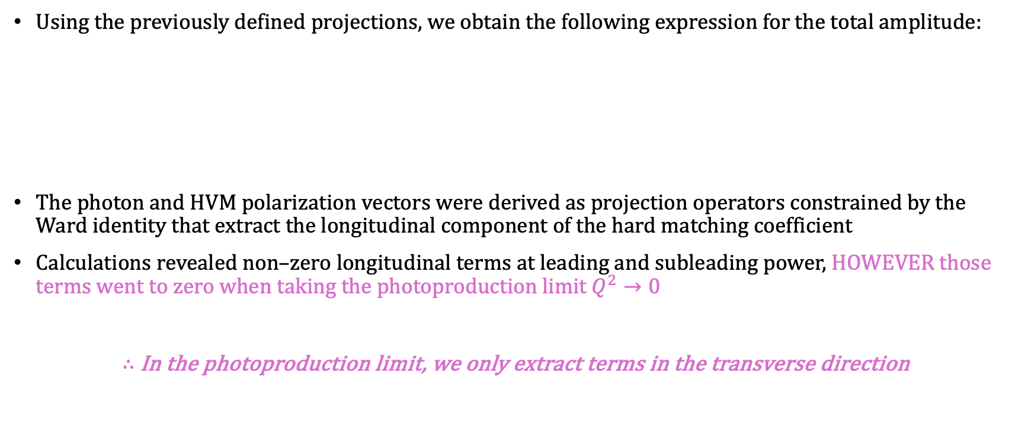
Hard matching coefficient – Longitudinal and Transverse components
Using the previously defined projections, we obtain the following expression for the total amplitude:
The photon and HVM polarization vectors were derived as projection operators constrained by the Ward identity that extract the longitudinal component of the hard matching coefficient
Calculations revealed non–zero longitudinal terms at leading and subleading power, HOWEVER those terms went to zero when taking the photoproduction limit $Q^{2}→0$
$∴$In the photoproduction limit, we only extract terms in the transverse direction
Polarization vectors for photon and HVM
Notes:
Discuss how the photon and HVM polarization vectors pull out the longitudinal components
Show tensor decomp?
Why is it natural here to decomp the amplitude into long and perp components? Because of GPDs?
Show my expressions for the projection operators?
Explain that in the results, there was a non-zero long component that went to 0 in the photoproduction limit

Slide 24
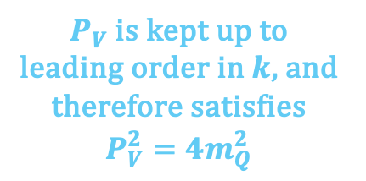
Hard matching coefficient
$P_{V}$ is kept up to leading order in $k$, and therefore satisfies $P_{V}^{2}=4m_{Q}^{2}$
Notes:
Pv is kept up to leading order in k and therefore satisfies Pv^2 = 4m_Q^2

Slide 25
Hard matching coefficient
Notes:
Show graph
Relativistic corrections show a significant difference
LP shows a divergence going from ERBL to DGLAP from the GPD which is to be expected?
But the subleading power has an even greater divergence
We don’t know how to handle it

Slide 26

Photoproduction cross section
Subleading hard matching coefficient:
Expand about $|x|≪|ξ|$ for the near-threshold region:
The differential cross section is then given by:
Notes:
The sum and averaging is over the polarization of the initial and final proton state
Squared moment of the GPD

Slide 27
Photoproduction cross section
The squared moment of the GPD has the form:
Where
Y. Guo, X. Ji and Y. Liu, QCD Analysis of Near-Threshold Photon-Proton Production of
Heavy Quarkonium, Phys. Rev. D 103 (2021) 096010 [2103.11506].
Notes:
GFFs are taken from lattice calculations with the t dependence in the tripole expansion being:

Slide 28
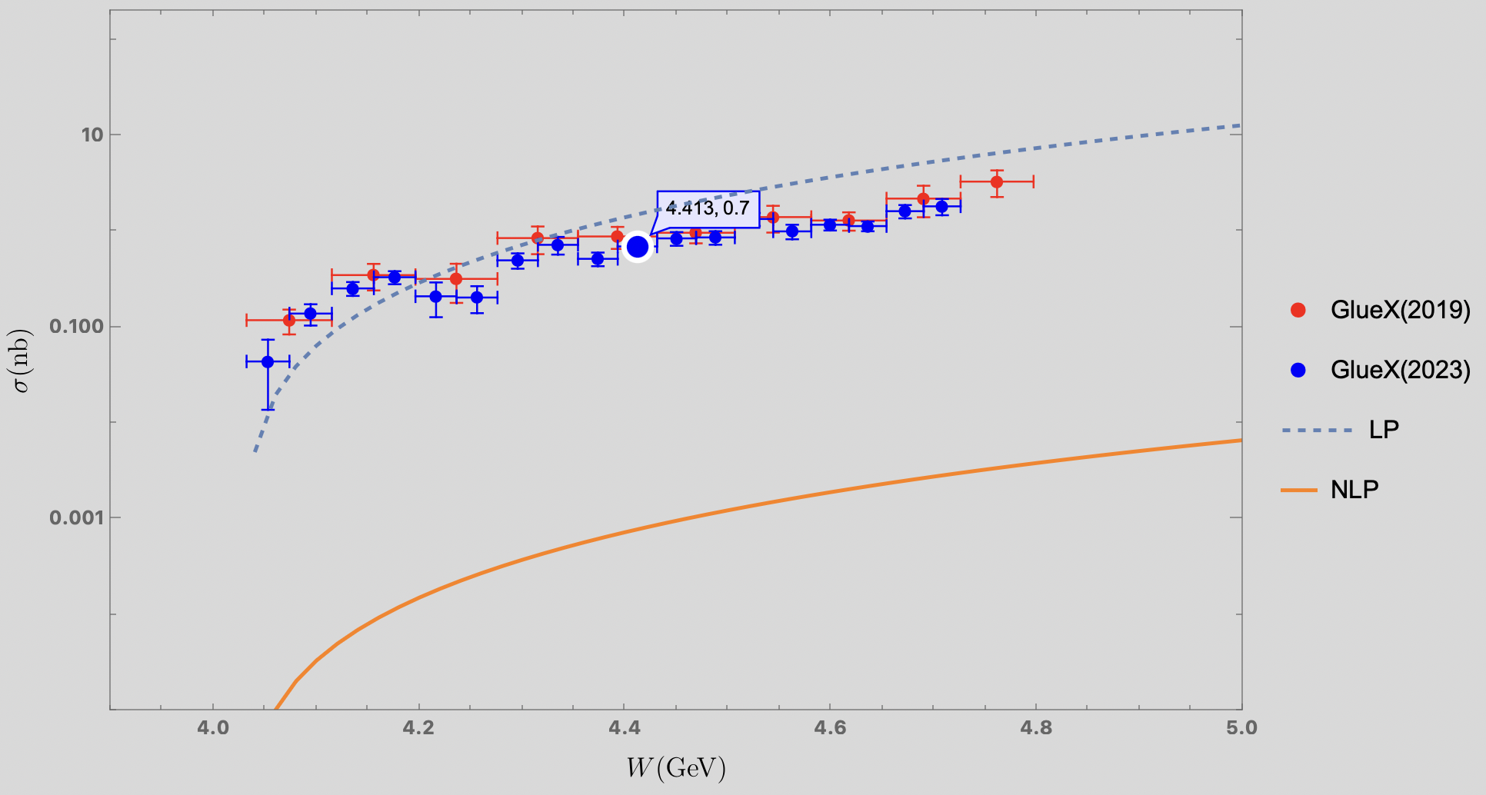

Photoproduction cross section - $J/ψ$
Notes:
We definitely need to include the higher moments for the relativistic correction. The cross-section is extremely small since the square of matching coefficient multiplying the moment of GPD is almost zero. The coefficient goes as (1-7v^2/3)^2. 7v^2/3 for charm quark is 0.97 making this almost zero. I have put the figure below with the corrected sign and the orange line represents NLP correction

Slide 29
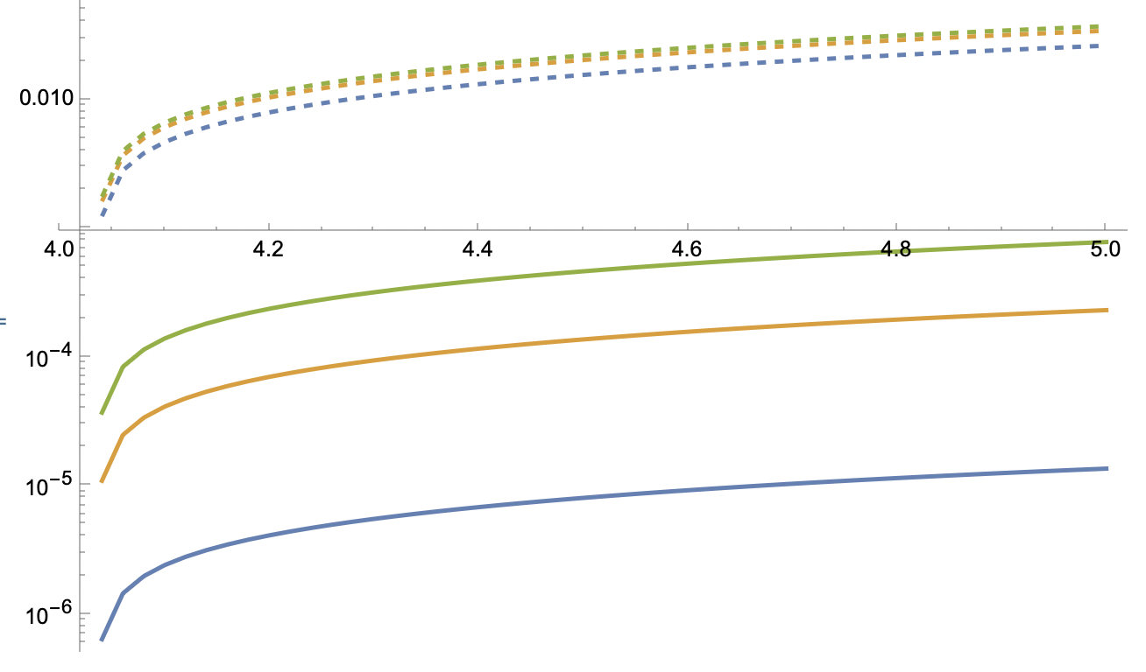
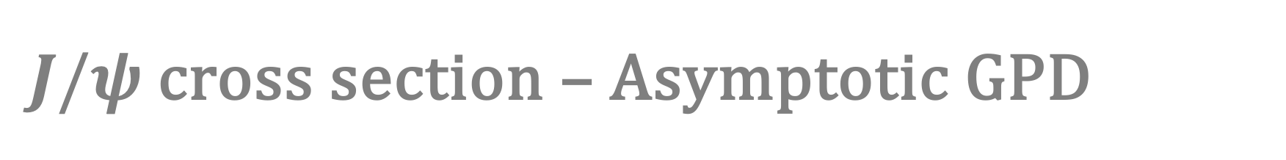
$J/ψ$ cross section – Asymptotic GPD
Dashed = LP
Solid = NLP
Blue = 0th moment
Orange = 2nd moment
Green = 4th moment
Notes:
We discussed today about the relativistic correction by taking some GPD models. I have two screenshots below for the cross-section as a function of W. For the first one I took GPD to be the asymptotic form we used in our paper and for the second one I took a truncated version of the Kroll & Goloskokov model (0611290 and I have just retained the first term in the GPD expansion). The dashed line corresponds to LP while the filled lines corresponds to NLP with blue, yellow and green corresponding to 0th, 2nd and 4th moment respectively. This shows that the result is sensitive to GPD model and <v^2> dependence of the matching coefficient. So we decided to use GUMP to get the moments to see if the GPD at LP converges and then see how much the NLP is going to push the result closer towards the data

Slide 30
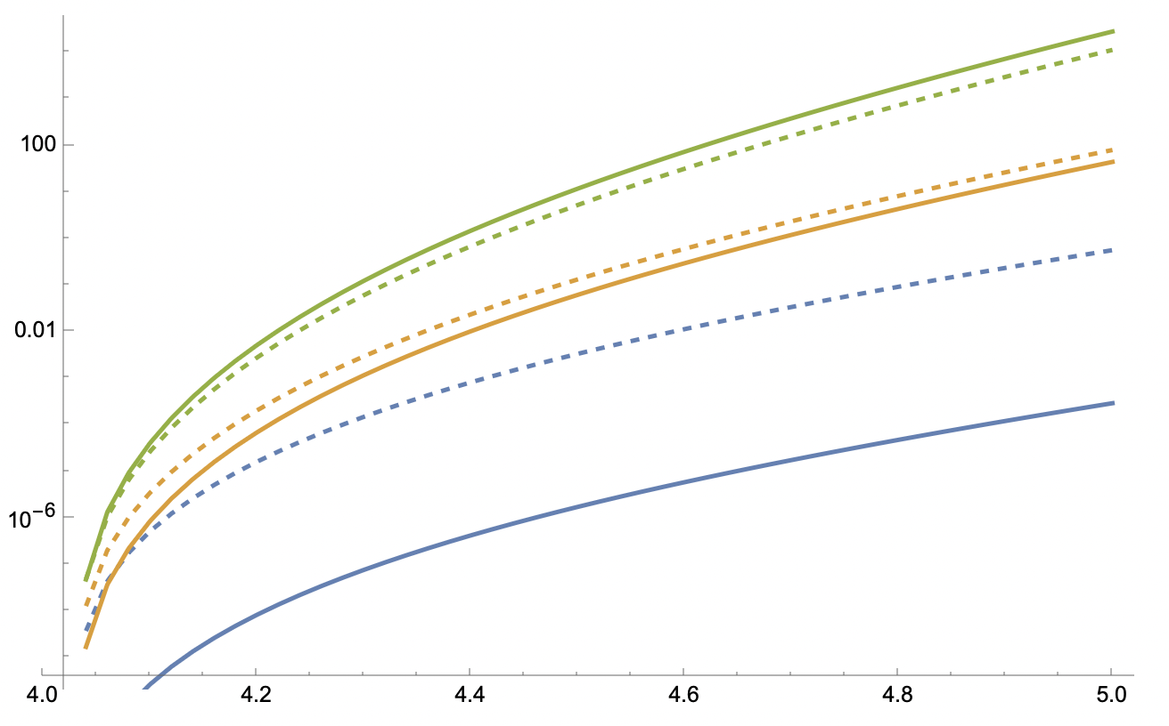
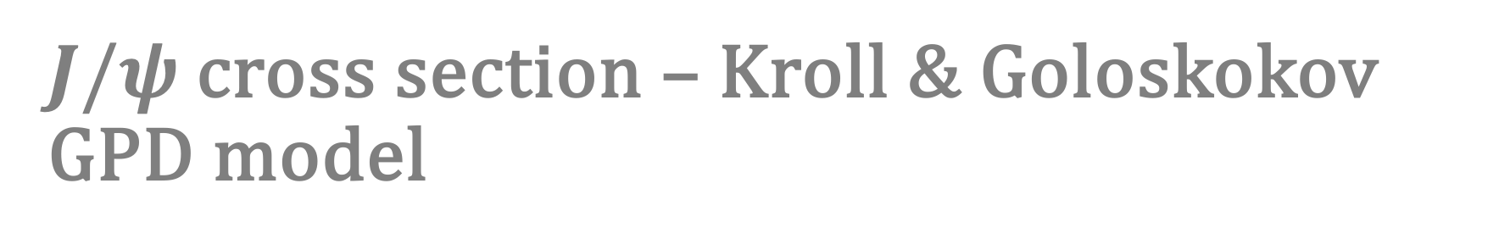
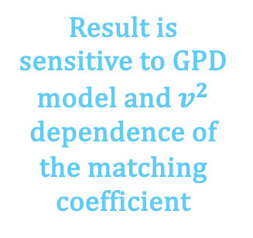
$J/ψ$ cross section – Kroll & Goloskokov GPD model
Dashed = LP
Solid = NLP
Blue = 0th moment
Orange = 2nd moment
Green = 4th moment
Result is sensitive to GPD model and $v^{2}$ dependence of the matching coefficient
Notes:
We discussed today about the relativistic correction by taking some GPD models. I have two screenshots below for the cross-section as a function of W. For the first one I took GPD to be the asymptotic form we used in our paper and for the second one I took a truncated version of the Kroll & Goloskokov model (0611290 and I have just retained the first term in the GPD expansion). The dashed line corresponds to LP while the filled lines corresponds to NLP with blue, yellow and green corresponding to 0th, 2nd and 4th moment respectively. This shows that the result is sensitive to GPD model and <v^2> dependence of the matching coefficient. So we decided to use GUMP to get the moments to see if the GPD at LP converges and then see how much the NLP is going to push the result closer towards the data

Slide 31
Conclusion
Using the first moment approximation for the GPD’s caused our relativistic corrections at NLP for our model to skew wildly from data
Analysis shows that 1st moment only contributes ~22% of relativistic corrections
Including higher moments of the GPD is crucial to calculation
Currently utilizing GUMP data to interpolate a GPD function so we can extract higher moments

Slide 32

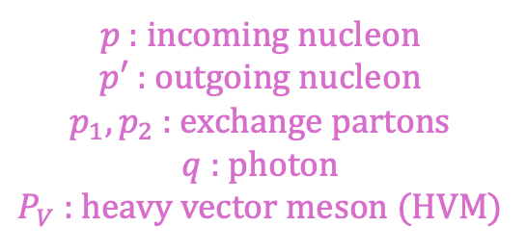
Kinematics in near-threshold limit
We define the lightcone coordinates in terms of the collinear vector $n^{μ}=\left(1,0,0,1\right)$ & anticollinear vector ${\overline{n}}^{μ}=(1,0,0,−1)$
Calculation done in Ji frame: mean of the large lightcone momentum component of the incoming/outgoing nucleon is taken along $n^{μ}$
$p$ : incoming nucleon
$p′$ : outgoing nucleon
$p_{1}, p_{2}$ : exchange partons
$q$ : photon
$P_{V}$ : heavy vector meson (HVM)
Notes:
Near threshold region: W^2 ~ Mv^2 >> -t
W = invariant mass of photon-proton system

Slide 33
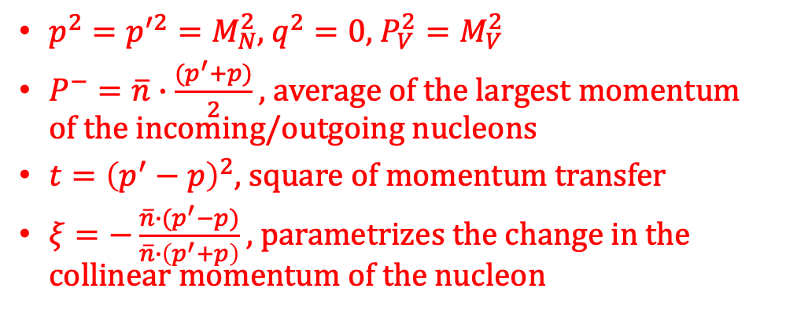
Kinematics in near-threshold limit
$p^{2}=p^{′2}=M_{N}^{2}$, $q^{2}=0$, $P_{V}^{2}=M_{V}^{2}$
$P^{−}=\overline{n}∙\frac{{(p}^{′}+p)}{2}$ , average of the largest momentum of the incoming/outgoing nucleons
$t={\left(p^{′}−p\right)}^{2}$, square of momentum transfer
$ξ=−\frac{\overline{n}∙(p^{′}−p)}{\overline{n}∙\left(p^{′}+p\right)}$ , parametrizes the change in the collinear momentum of the nucleon
$p$ : incoming nucleon
$p′$ : outgoing nucleon
$p_{1}, p_{2}$ : exchange partons
$q$ : photon
$P_{V}$ : heavy vector meson (HVM)
Notes:
Momentum decomposition in terms of the light-cone basis vectors in the near-threshold limit
W = invariant mass of the photon-proton system

