Slide 1
Lepton-nucleus Scattering with Density Functional Model
한국항공대학교
김경식
2025. 01. 18

Slide 2
※ Published works with Prof. Hyun and Dr. Gil
1. Neutron skin of 27Al with Skyrme and Korea-IBS-Daegu-SKKU
density functionals : Modern Physics Letters A, 39, 2350184, (2024)
2. Exclusive (e,e’p) reaction : PRC 104, 044613 (2021)
3. Inclusive (e,e’) reaction : PRC 105, 024607 (2022)
4. Charged-current neutrino-nucleus scattering :
PLB 833, 137273 (2022), Chinese Physics C 48, 084101 (2024)
5. Effect of neutrino’s electromagnetic properties : submitted to PRC
with Profs. Hyun and Nam

Slide 3
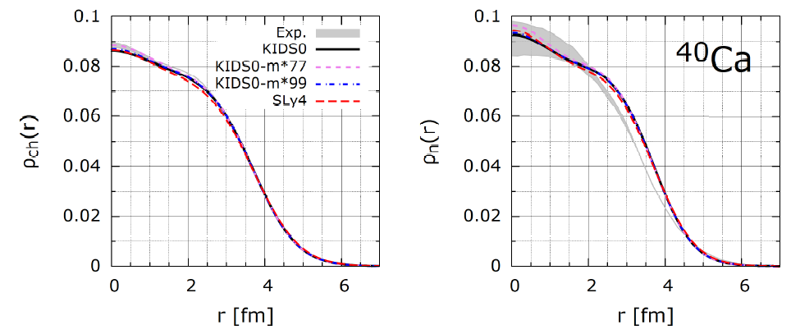
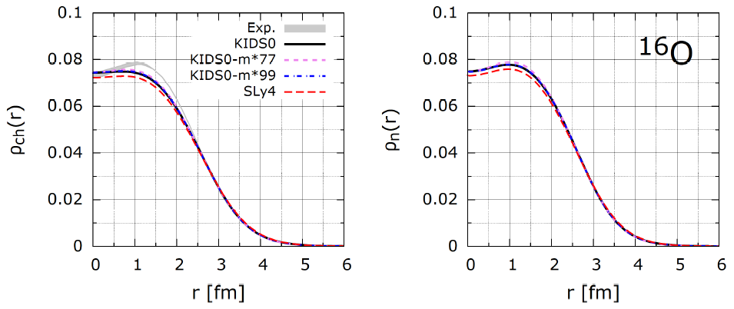
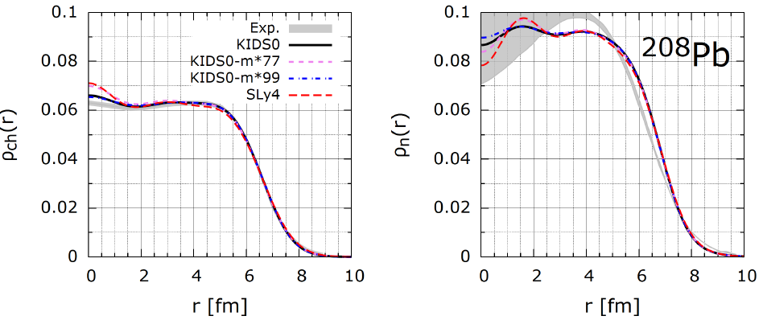
Model
Isoscalar and isovector effective mass ratios are defined as
$μ_{S}=\frac{m_{S}^{∗}}{M}$, and $μ_{V}=\frac{m_{V}^{∗}}{M}$, where $m_{S}^{∗}$ and $m_{V}^{∗}$ are effective masses, respectively.

Slide 4
1. Neutron skin of 27Al with Skyrme and Korea-IBS-Daegu-SKKU
density functionals
The neutron skin thickness ($R_{np}$) for 208Pb is 0.283$±$0.071 fm at Jlab (PREX1).
At Jlab (PREX2), the neutron skin thickness for 27Al is -0.04$±$0.12 fm and the parity-violating asymmetry ($A_{pv}$) was measured as
$A_{pv}=(2.16±0.11±0.16)×{10}^{−6}$.
Target 27Al is open-shell and odd-number nucleus, so that the effect of the pairing has to be included.
We use constant force for the pairing force given
$Δ_{q}=G_{q}\sum_{β∈q}{\sqrt{w_{β}\left(1−w_{β}\right)}} with G_{q}=\frac{22}{A}$ and occupation probability $w_{β}$ in the given orbit. There is a hole state of proton in the $d_{5/2}$ level.
29. NPA584, 467 (1995). 30. PRC 40, 2834 (1989). 31. NPA 635, 231 (1998).
32. PRC 72, 014310 (2005). 33. NPA 386, 79 (1982). 34. PRC 73, 014313 (2006).
35. Acta Phys Pol BB 48, 305 (2017). 36. New Phys. 67, 456 (2017).
37. PRC 99, 064319 (2019). 38. NPS 688, 349 (2001).

Slide 5
The parity-violating asymmetry $A_{pv}$ is defined by
$A_{pv}=\frac{\frac{{dσ}_{+}}{dΩ}−\frac{{dσ}_{−}}{dΩ}}{\frac{{dσ}_{+}}{dΩ}+\frac{{dσ}_{−}}{dΩ}}$, where the subscript + and – denote the helicity of incoming electron.
If both neutrons and protons are distributed equally and symmetrically within a nucleus, $A_{pv}^{0}=−\frac{G_{F}Q_{W}}{4\sqrt{2}παZ}q^{2}$.
Weak charge : $Q_{W}=Q_{n}N+Q_{p}Z$, with $Q_{n}=−1$ and $Q_{p}=1−4{\left(\sin{θ_{W}}\right)}^{2}$.
The three momentum transfer $q^{2}=4E_{i}E_{f}{\left(\sin{\frac{θ}{2}}\right)}^{2}+{\left(E_{i}−E_{f}\right)}^{2}=4E_{i}^{2}{\left(\sin{\frac{θ}{2}}\right)}^{2}$.
$A_{pv}$ is given in the Born approximation as
$A_{pv}=A_{pv}^{0}\frac{C_{0}C_{0}^{W}+C_{2}C_{2}^{W}+C_{4}C_{4}^{W}}{C_{0}^{2}+C_{2}^{2}+C_{4}^{2}}$.
The form factors of proton are defined by
$C_{0}\left(q\right)=\frac{1}{Z}\int{d^{3}rρ_{0}^{p}\left(r\right)j_{0}\left(qr\right),}$ $C_{2}\left(q\right)=\frac{1}{Z}\sqrt{\frac{10}{7}}\int{d^{3}r\frac{1}{4π}{\left|R_{d5/2}^{p}\left(r\right)\right|}^{2}j_{2}(qr)},$
$C_{4}\left(q\right)=\frac{1}{Z}\sqrt{\frac{2}{7}}\int{d^{3}r\frac{1}{4π}{\left|R_{d5/2}^{p}\left(r\right)\right|}^{2}j_{4}(qr)}.$
Weak form factors are
$C_{0}^{W}\left(q\right)=\frac{1}{Q_{W}}\left[Q_{n}NF_{n}\left(q\right)+Q_{p}ZC_{0}(q)\right]$ , $C_{2}^{W}\left(q\right)=\frac{Q_{p}}{Q_{W}}ZC_{2}(q)$, $C_{4}^{W}\left(q\right)=\frac{Q_{p}}{Q_{W}}C_{4}(q)$,
Where $F_{n}\left(q\right)=\frac{1}{N}\int{d^{3}rρ_{0}^{n}(r)e^{i\vec{q}∙\vec{r}}}$and $ρ_{0}^{n}(r)$ is the neutron distribution.

Slide 6
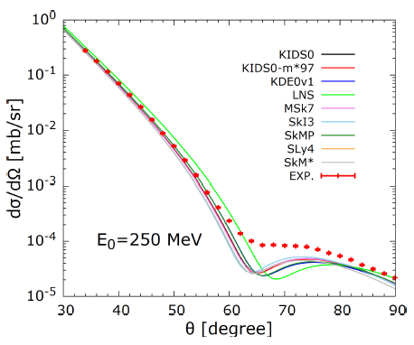
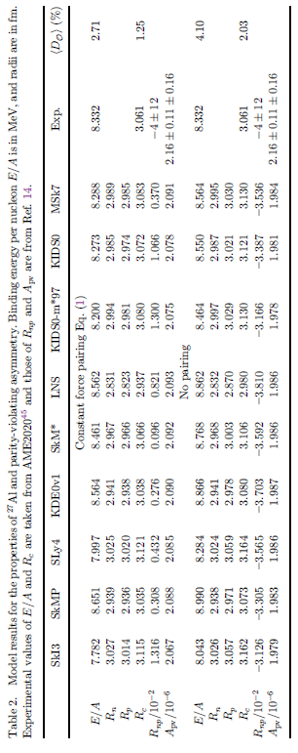

Slide 7
Summary
Obtain the neutron skin thickness of 27Al about $0.001≲R_{np}≲0.013$ fm.
The $R_{np}$ is almost independent of the effective mass and symmetry energy.
The pairing force plays a crucial role of making the sign of the $R_{np}$.
With/without the pairing force, the radius of neutron is almost unchanged but that of proton is reduced due to the pairing.
The theoretical $A_{pv}$ with the pairing describes the experimental value well.

Slide 8
2. Exclusive (e,e’p) reaction
The (e,e’p) differential cross section is given by
$\frac{d^{3}σ}{{dE}_{f}{dΩ}_{f}{dΩ}_{p}}=\frac{{pE}_{p}}{{\left(2π\right)}^{3}}σ_{M}\left(v_{L}R_{L}+v_{T}R_{T}+\cos{{2φ}_{p}}v_{TT}R_{TT}+\cos{φ_{p}}v_{LT}R_{LT}+h\sin{φ_{p}}v_{LT′}R_{LT′}\right)$,
where the Mott cross section $σ_{M}={\left(α/2E\right)}^{2}\left[\cos^{2}(θ_{e}/2)/\sin^{4}(θ_{e}/2)\right]$.
The kinematics factors are given by
$v_{L}=\frac{q_{μ}^{4}}{q^{4}}, v_{T}={\left(\tan{\frac{θ_{e}}{2}}\right)}^{2} − \frac{q_{μ}^{2}}{{2q}^{2}}, v_{TT}=−\frac{q_{μ}^{2}}{{2q}^{2}}$,
$v_{LT}=−\frac{q_{μ}^{2}}{q^{2}}\left[{\left(\tan{\frac{θ_{e}}{2}}\right)}^{2}−\frac{q_{μ}^{2}}{q^{2}}\right], v_{LT′}=−\frac{q_{μ}^{2}}{q^{2}}\tan{\frac{θ_{e}}{2}}$.
The response functions are written as
$R_{L}=W_{00}, R_{T}=W_{11}+W_{22}, \cos{{2φ}_{p}R_{TT}=W_{11}−W_{22}}$,
$\cos{φ_{p}R_{LT}=W_{01}−W_{10}, \sin{φ_{p}R_{LT′}=−i\left(W_{02}−W_{20}\right)}}.$
The nuclear tensor is a sum over the spins of the bound and final nucleons
$W_{μν}=\sum_{s_{b}{,s}_{p}}{N_{μ}^{∗}N_{ν}}$, and $N^{μ}=\int{J^{μ}\left(\vec{r}\right)}e^{i\vec{q}∙\vec{r}}d^{3}r$.
The nucleon transition current is given by $J^{μ}\left(\vec{r}\right)=e{\overline{ψ}}_{p}\left(\vec{r}\right){\hat{J}}^{μ}ψ_{b}\left(\vec{r}\right)$.

Slide 9
The current operator consists of the Dirac and the Pauli parts:
${\hat{J}}^{μ}=F_{1}γ^{μ}+ F_{2}\frac{{iμ}_{T}}{2M}σ^{μν}q_{ν}$.
The nucleon anomalous magnetic moments are given by
$μ_{T}=1.793$ for proton and $μ_{T}=−1.91$ for neutron.
The form factors are related to the electric and magnetic Sachs form:
$G_{E}=F_{1}+\frac{μ_{T}q_{μ}^{2}}{{4M}^{2}}F_{2}$, and $G_{M}=F_{1}+μ_{T}F_{2}$,
$G_{E}=\frac{1}{{\left(1−\frac{q_{μ}^{2}}{Λ^{2}}\right)}^{2}}= G_{M}/(μ_{T}+1)$,
here, $Λ=0.71$ in units of (GeV/c)$2$ .
parallel kinematics
p
p_{m}
θp
q
θe
e
e’
perpendicular kinematics
Reduced cross section :
extracted the off-shell electron-nucleon cross section
$ρ_{m}(p_{m})=\frac{1}{{pE}_{p}σ_{ep}}\frac{d^{3}σ}{{dE}_{f}{dΩ}_{f}{dΩ}_{f}}$,
where the missing momentum is defined by ${\vec{p}}_{m}=\vec{p}−\vec{q}$.
Use the different spectroscopic factor (SF) for each states, which represents the probability of occupying a given state.
The value of SF should be between 1 and 0.
θp
q
p_{m}
p
θe
e
e’

Slide 10
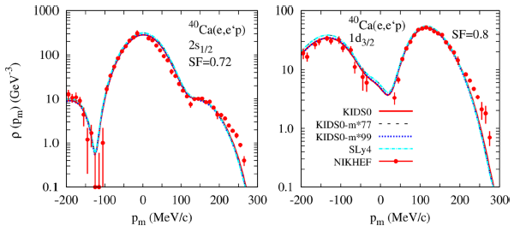
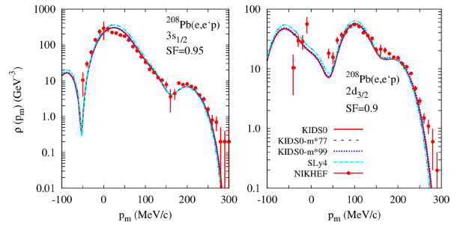
parallel kinematics
 |  | This work | Ref. 1 | Ref. 2 | Ref. 3 | Ref. 4
40Ca | 2s1/2 | 0.72 | 0.75 | 0.51 | 0.87 | 0931
 | 1d3/2 | 0.65 | 0.80 | 0.76 | 0.93 | 0.966
208Pb | 3s1/2 | 0.95 | 0.71 | 0.70 | 0.85 | 0.929
 | 2d3/2 | 0.9 | - | 0.73 | 0.9 | 0.937
PRC 45, 1311 (1992).
PRC 48, 2731 (1993).
3. arXiv:0709.3535 [nuth-th].
4. EuroPhys. Lett. 107,
62001 (2014).

Slide 11
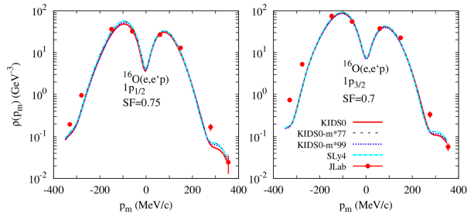
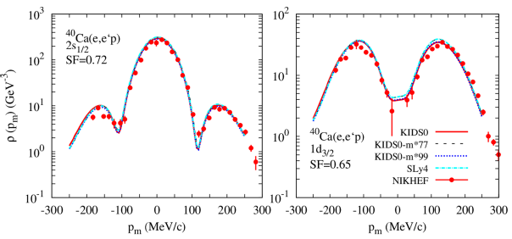
perpendicular kinematics

Slide 12
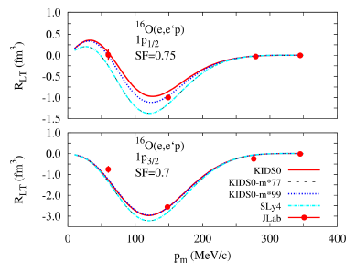
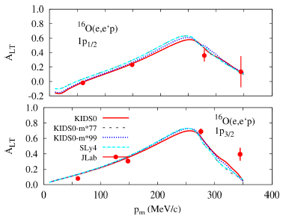
The (e,e’p) differential cross section is given by
$\frac{d^{3}σ}{{dE}_{f}{dΩ}_{f}{dΩ}_{p}}=\frac{{pE}_{p}}{{\left(2π\right)}^{3}}σ_{M}\left(v_{L}R_{L}+v_{T}R_{T}+\cos{{2φ}_{p}}v_{TT}R_{TT}+\cos{φ_{p}}v_{LT}R_{LT}+h\sin{φ_{p}}v_{LT′}R_{LT′}\right)$.
The fourth response function is given by
$R_{LT}=\frac{σ^{R}−σ^{L}}{{2Kv}_{LT}}$
L(left) and R(right) indicate the left side at $φ_{p}=0$ and the right side at $φ_{p}=π$ of the differential cross section, respectively.
The left-right asymmetry is defined as
$$A_{LT}=\frac{σ^{R}−σ^{L}}{σ^{R}+σ^{L}}$$

Slide 13
Summary
The dependence on the effective mass is dominated by the isoscalar effective mass, and the role of the isovector effective mass can be neglected.
In light nuclei like 16O, the distributions of the proton and neutron are insensitive to the isoscalar effective mass, but in 208Pb, the effect appears clearly.
In light nuclei like 40Ca, the contribution of isoscalar effective mass is negligible but in 208Pb, the cross section depends on it for the exclusive (e,e’p) reaction.
Although the left-right asymmetry is insensitive to isoscalar effective mass, the contribution to the fourth response function tends to be large with smaller mass.

Slide 14
3. Inclusive (e,e’) reaction
The (e,e’p) differential cross section
$\frac{d^{3}σ}{{dE}_{e}{dΩ}_{e}{dΩ}_{p}}=\frac{{pE}_{p}}{{\left(2π\right)}^{3}}σ_{M}\left\{v_{L}R_{L}+v_{T}R_{T}\right.+ \cos{{2φ}_{p} v_{TT}R_{TT}+ \cos{φ_{p} v_{LT}R_{LT}}}$
$+ h\sin{φ_{p} {v′}_{LT} {R′}_{LT}\}}$
The (e,e’) differential cross section is obtained by integrating over the angle of
the final nucleon
$\frac{d^{2}σ}{{dωdΩ}_{e}}=σ_{M}\left\{\frac{Q^{4}}{q^{4}}S_{L}\left(q,ω\right)+ \left[{\left(\tan{\frac{θ_{e}}{2}}\right)}^{2}+\frac{Q^{2}}{{2q}^{2}}\right]S_{T}(q,ω)\right\}$,
where $Q^{2}=q^{2}−ω^{2}$ is the four-momentum transfer squared.
The energy transfer $ω= E_{i} − E_{f}$, where $E_{i,f}$ is incident (outgoing) electron energy.
The longitudinal and transverse structure functions are squares of the Fourier
transform of components of the nuclear transition current density for a given
bound state with total angular momentum $j_{b}$:
$S_{L}\left(q,ω\right)=\sum_{μ_{b}{,j}_{b}}{\frac{ρ_{p}}{2(2j_{b}+1)}\int{{|N_{0}|}^{2}{dΩ}_{p}}}$, ${ S}_{T}\left(q,ω\right)=\sum_{μ_{b}{,j}_{b}}{\frac{ρ_{p}}{2(2j_{b}+1)}\int{{(|N_{x}|}^{2}+{|N_{y}|}^{2}){dΩ}_{p}}}$,
where the density of state of the final nucleon is defined as $ρ_{p}={pE}_{p}/{(2π)}^{3}$.

Slide 15
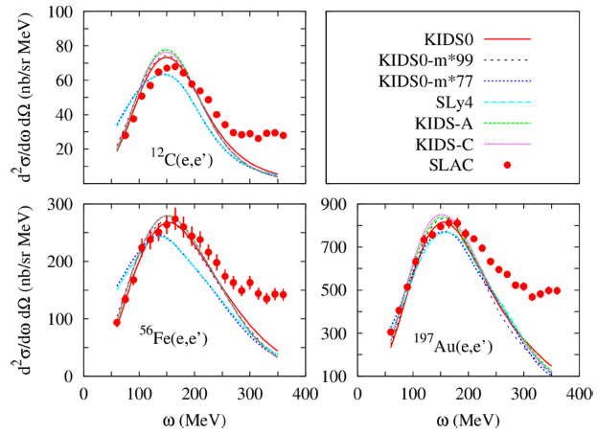
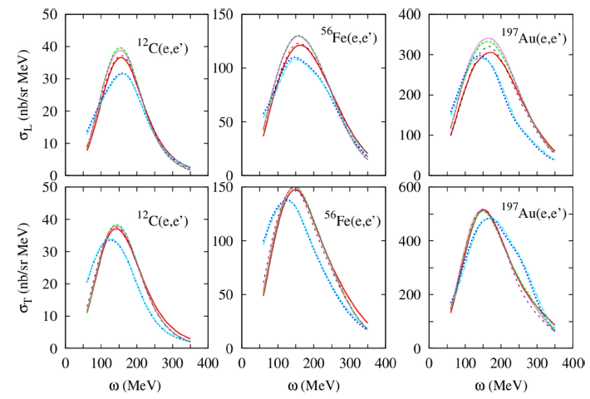
The incident electron energy
E=2.02 GeV.
Scattering angle $θ_{e}$=${15}^{0}$.
The data is from SLAC.

Slide 16
Summary
Inclusive (e,e’) reaction supports the isoscalar effective mass in range (0.9-1.0)M and the effect of the mass in the range (0.7-0.9)M moves the peak position and suppresses the magnitude of cross sections.
Even though the coefficients of the symmetry energy vary over a wide range, the effect of the symmetry energy makes a few percent difference in the cross section.
The effect appears clearly in the longitudinal cross section though it is very small in the transverse cross section.

Slide 17
4. Charged-current neutrino-nucleus scattering
The differential cross section of charged-current (CC) reaction for neutrino scattering is given by
$\frac{dσ}{{dT}_{N}}={4π}^{2}\frac{M_{N}M_{A−1}}{{(2π)}^{2}M_{A}}\int{\sin{θ_{l}{dθ}_{l}}}\int{\sin{θ_{N}{dθ}_{N} p}f_{rec}^{−1}σ_{M}^{W}\left(v_{L}R_{L}+v_{T}R_{T}+{hv′}_{T}{R′}_{T}\right)}$,
where $M_{N},$ $M_{A}$, $M_{A−1}$, and $h$ are masses of nucleon, target nucleus, residual nucleus, and helicity of neutrino.
The recoil factor is given by $f_{rec}=\frac{E_{A−1}}{M_{A}} \left|1+ \frac{E}{E_{A−1}}\left[1− \frac{\vec{q}⋅\vec{p}}{p^{2}}\right]\right|$.
The kinematics factor $σ_{M}^{W}$ is defined by $σ_{M}^{W}=\sqrt{1−\frac{M_{l}^{2}}{E_{f}}}{\left(\frac{G_{F}\cos{(θ_{C})} E_{f}M_{W}^{2}}{2π(Q^{2}+M_{W}^{2})}\right)}^{2}$.
$M_{W}$ and $θ_{l}$ are the mass of W-boson and scattering angle, respectively.
The Cabibbo angle $θ_{C}$ is given by $\cos^{2}{θ_{C}≃0.9749}$.
The relativistic nucleon weak current operator is given by
$$J^{μ}= F_{1}\left(Q^{2}\right)γ^{μ}+i \frac{κ}{{2M}_{N}}F_{2}\left(Q^{2}\right)σ^{μν}q_{ν} + G_{A}\left(Q^{2}\right)γ^{μ}γ_{5}+ \frac{1}{{2M}_{N}}G_{P}\left(Q^{2}\right)q^{μ}γ_{5},$$
where the weak form factors are written as
$F_{i}^{V,p(n)}= F_{i}^{p(n)}(Q^{2}) − F_{i}^{n(p)}(Q^{2})$.
The axial form factor for CC reaction is given by $G_{A}\left(Q^{2}\right)=−g_{A}/{\left(1+\frac{Q^{2}}{M_{A}^{2}}\right)}^{2},$
with $g_{A}=1.262$ and two values for $M_{A}=1.032$and $1.30$ GeV.
The pseudoscalar form factor $G_{P}\left(Q^{2}\right)=\frac{{2M}_{N}}{Q^{2}+m_{π}^{2}}G_{A}(Q^{2})$,
where $m_{π}$ is the pion mass and the factor vanishes for NC reaction.

Slide 18
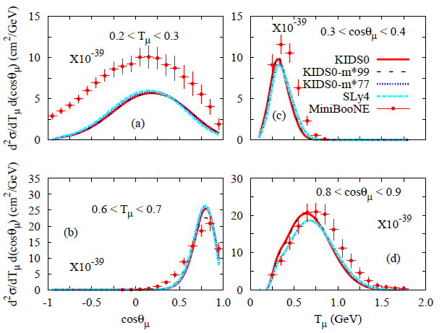
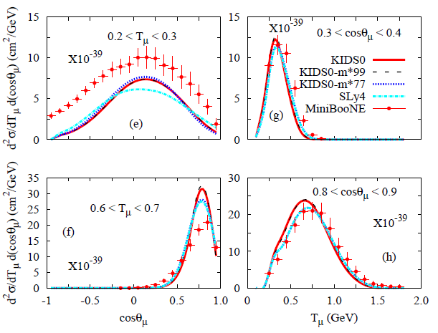
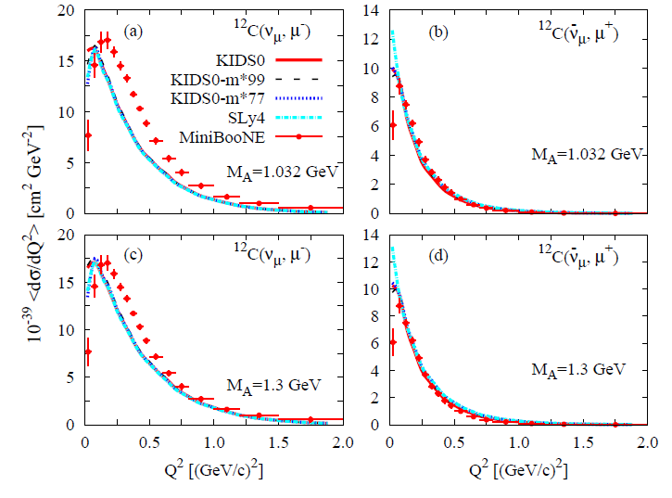
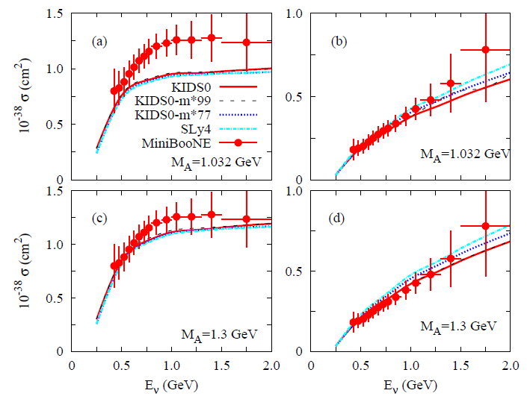
MiniBooNE data $ν_{μ}+n ⟶ μ^{−}+p$, ${\overline{ν}}_{μ}+p ⟶ μ^{+}+n$

Slide 19
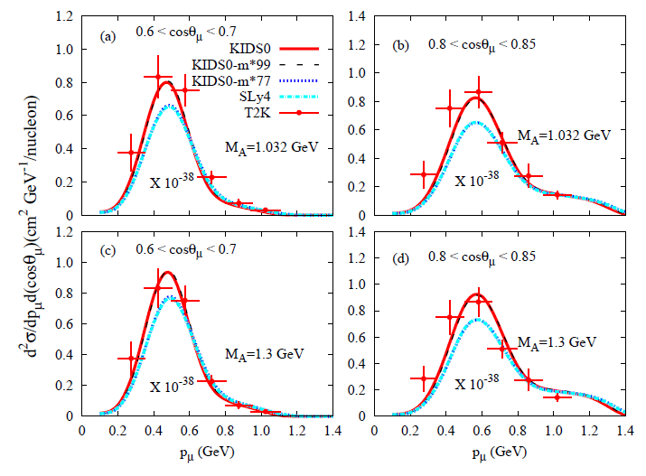
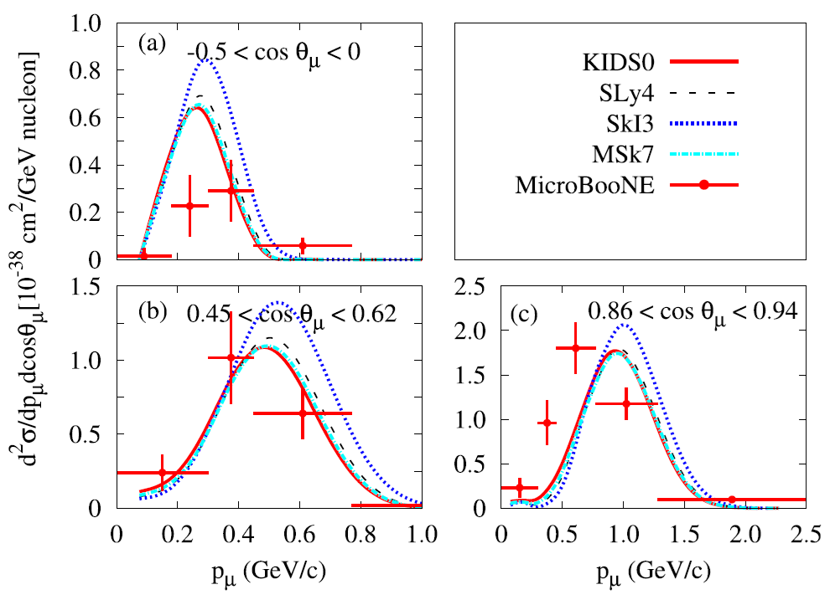
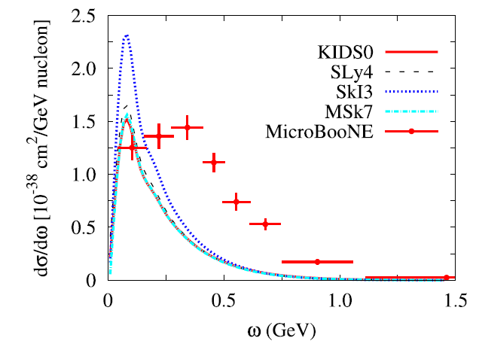
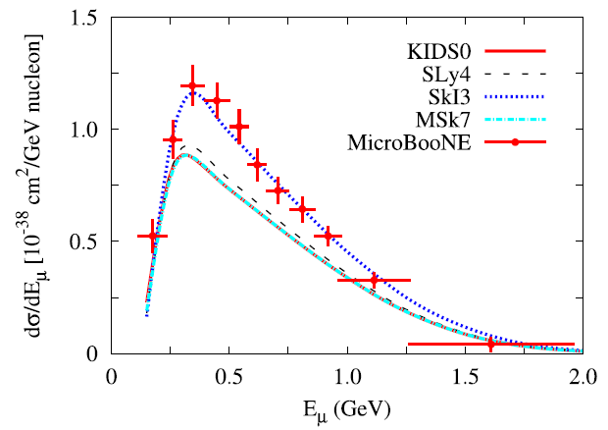
T2K data from 12C and MicroBooNE from 40Ar
$ν_{μ}+n ⟶ μ^{−}+p$

Slide 20
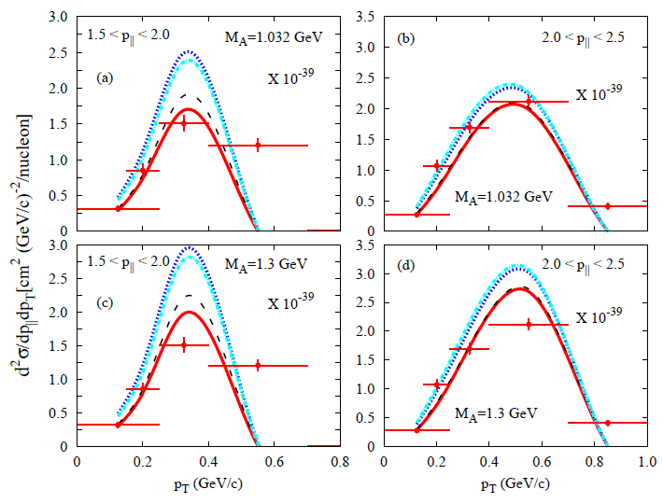
MINER$ν$A data
${\overline{ν}}_{μ}+p ⟶ μ^{+}+n$

Slide 21
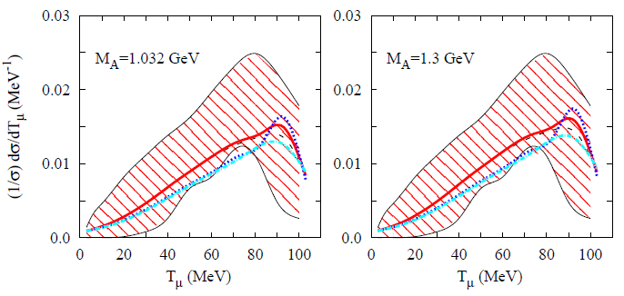
KDAR (kaon-decays-at rest) data :
when a positive kaon at rest decays, monoenergetic muon neutrinos are created at 236 MeV.

Slide 22
Summary
Results of the KIDS EDF are in good agreement with the T2K and MINER$ν$A data with $μ_{s}≃1$.
In the comparison with the MiniBooNE data, role of the effective mass becomes less dominant compared to the T2K and MINER$ν$A data, but the effect of the axial mass becomes crucial.
For the total cross section of the neutrino, the standard value of the axial mass $M_{A}=1.032$ GeV fails to reproduce the neutrino data.
The effect of the axial mass $M_{A}$ is small at low incident energies of the neutrino,
but the effect increases with higher neutrino energies.
The double-differential cross sections in the models do not provide the data reported from MicroBooNE.
The cross sections agree with the data at forward angles but they do not agree with the data at backward angles.
The single-differential cross sections were also calculated in terms of energy transfer and compared with the data measured from MicroBooNE.
The theoretical results do not describe the data at all owing to the various entangled reaction channels.
The theoretical cross sections of the SkI3 model agree with the MicroBooNE
data for the outgoing muon energy relatively well, but the other models
underestimate the data.

Slide 23
Thank you for your attention

Slide 24
Nonunitary transformation :
For the nucleon wave functions, we solve the Dirac equation
$\left[γ_{μ}p^{μ}−M−S\left(r\right)−γ^{0}V\left(r\right)\right]Ψ\left(r\right)=0$.
Redefine the wave function as
$Ψ^{′}\left(r\right)=exp⁡[−\frac{1}{2}γ^{0}\ln{D(r)]Ψ(r)}$,
where $D(r)$ is the Darwin nonlocal factor and the Dirac equation is rewritten as
$\left[γ_{μ}p^{μ}−M−\frac{1}{2}U(r)−\frac{1}{2}γ^{0}U\left(r\right)+i\vec{α}⋅ \hat{r}T(r)\right]Ψ^{′}\left(r\right)=0$,
where $U\left(r\right)=S+V+\frac{M−E+S+V}{M+E}(S−V)$, $T\left(r\right)=−\frac{1}{2}\frac{d}{dr}\ln{D(r)}$.
We obtain relativistic potentials $S(r)$ and $V(r)$ from nonrelativistic potential.
The relativistic potentials are given by
$S\left(r\right)=\frac{1}{2}\left\{\frac{1}{D}\left[U_{non}−(M−E)(D−1)\right]+(M+E)(D−1)\right\}$,
$V\left(r\right)=$ $\frac{1}{2}\left\{\frac{1}{D}\left[U_{non}−(M−E)(D−1)\right]−(M+E)(D−1)\right\}$.
$D\left(r\right)=$exp$\left[−2\int_{r}^{∞}{MrV_{so}\left(r\right)dr}\right]$,
$U_{non}=\frac{2M}{E+M}\left[V_{cen}+\frac{1}{2M}T^{2}+\frac{2T}{r}+\frac{dT}{dr}+V_{coul}\right]$,
$T\left(r\right)={MrV}_{so}$.

Slide 25
