Slide 1
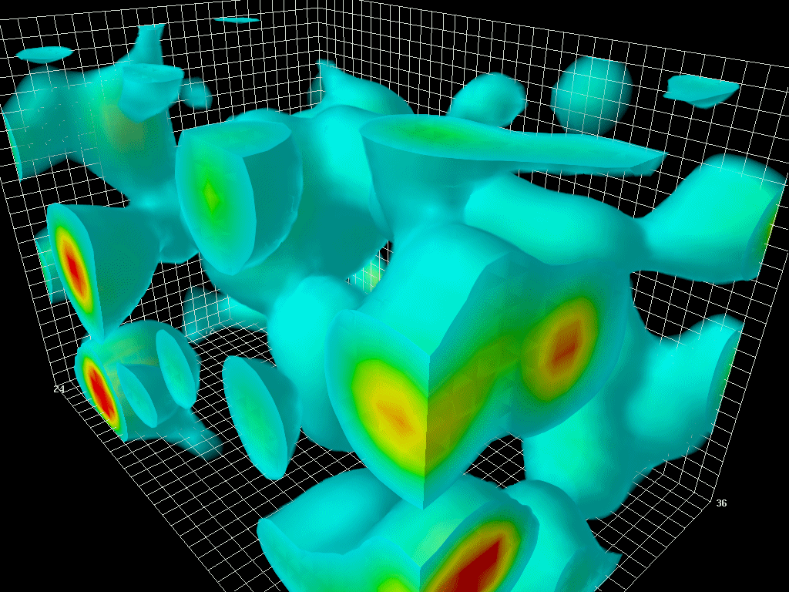
Effective heavy-light quark interaction from QCD instanton vacuum
Speaker: Nurmukhammad Rakhimov, CENuM, Korea University
In collaboration with
H.-C.Kim(Inha Un.),
K.Hong(Inha Un.),
M.Musakhanov(NUUz), U.Yakhshiev(Inha Un.).
Reviews from the works of
D.Diakonov, V.Petrov, P.Pobylitsa, E.Shuryak, I.Zahed,
M.Musakhanov, others(see ref.s)
The QCD action density in lowest energy state,
[visualization by D. Leinweber, 2004]
2025 CENuM Workshop, Jeju Kal hotel, January 16-19

Slide 2
Overview
Instanton ensemble
Light quarks in the background of instanton ensemble
Heavy quarks in the background of instanton ensemble
Heavy-light quark interaction in the instanton framework
Conclusion and Outlook

Slide 3
Motivation
A heavy quark in a heavy-light system remains as a static color source, so quark-gluon dynamics inside this system is governed by light quarks
Since light quarks dictate the dynamics inside heavy mesons, chiral symmetry and its spontaneous breakdown come into crucial play in describing the heavy mesons
Both heavy quark spin-flavor symmetry and chiral symmetry must be considered when constructing an effective theory for the heavy-light quark system [H.Georgi 1991, M. Wise 1993]
The instanton vacuum provides a theoretical framework for realizing the spontaneous breakdown of chiral symmetry (SBχS) in QCD. The effective low-energy partition function derived from the instanton vacuum has been successfully applied to low-lying light hadrons and singly heavy baryons in the limit of the infinitely heavy-quark mass[see works from D. Diakonov, V. Petrov and H.C.Kim et al]

Slide 4
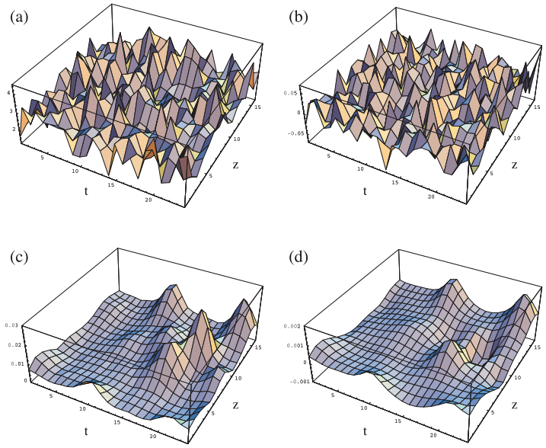
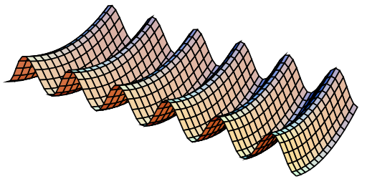
What are the instantons?
Potential energy of the gluon field
[A figure from D.Diakonov, 2003]
Tunneling process in Minkowski space,
pseudoparticle in Euclidean space
[Chu et al., 1994]
Self-dual classical solution:
$z_{ }$ - position of centre, $ρ_{ }$ - size, $U_{ }$ - orientation, overall $4N_{c}$ collective coordinates
Topologically charged , strong field inside .

Slide 5
Instanton ensemble
Classical gauge field
Partition function for a background classical $A_{μ}^{cl.}$ field and small oscillations $B_{μ}, { A}_{μ}=A_{μ}^{cl.}+B_{μ}$
– averaging over instanton endemble
Instanton media was stabilized at $ρ/R≃1/3$, average size $ρ≈0.3 fm$, separation $R≈1 fm$
Instanton are well separated, but interactions big enough . Thus instanton media is called Instanton Liquid
[D.Diakonov, V.Petrov 1984; E.Shuryak, T.Schafer 1993 ]

Slide 6
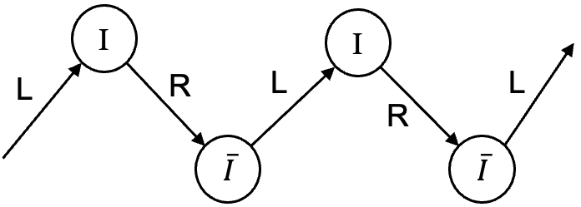
Light quarks in the background of the instanton ensemble
Interactions flip chirality
Chiral symmetry breaking
Chiral condensate
Pseudoscalar Goldstone bosons – pions
Dynamical quark mass:

Slide 7
Instanton induced interaction
In the 1-instanton background:
Spectrum contain zero & nonzero modes:
:zero modes dominate, :free propagator
Approximate Green’s function:
Action:
In the background of $N_{+}$ $I$’s & $N_{−}$ $\overline{I}$’s

Slide 8
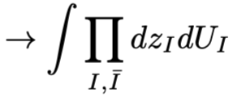
Instanton induced interaction
Partition function:
Averaging over the ensemble $⇒$ averaging over collective coordinates of each $I$& $\overline{I}$
After averaging:
Saddle point $λ_{s}$ defines dynamical quark mass $M(k)$.
replace all (anti)instantons with average-size one
size dist. func.
t’Hooft vertex

Slide 9
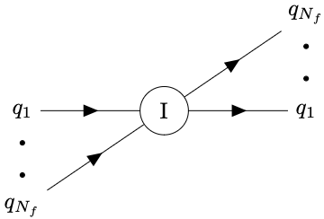
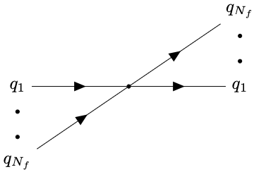
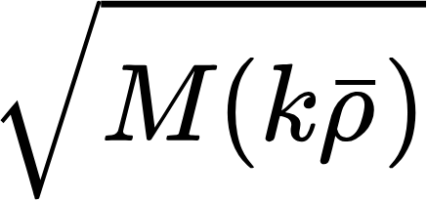
Instanton induced interaction
$N_{f}=1:$ mass term
$N_{f}=2$: 4-fermion interaction
Any $N_{f}$:
Diagrammatic interpretation:
form factor function
attached each quark leg
[t’Hooft 1976; D.Diakonov, V.Petrov 1986; M.Nowak 1991;
R.Rapp, T.Schafer, E.Shuryak, M.Velkovysky 1999 and others]

Slide 10
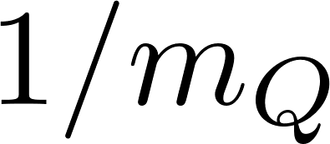
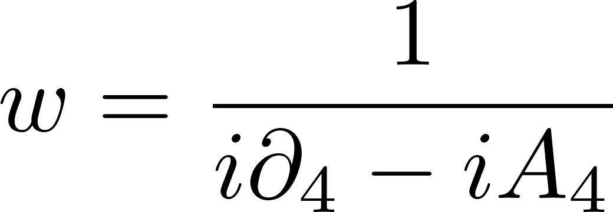
Heavy quarks (infinite mass limit)
In limit the heavy quark inside the heavy hadron is almost on shell:
Project out particle and anti-particle components:
Eliminate anti-particle fields from the Lagrangian using EOM and perform expansion
The Lagrangian leading order in :
HQ propagator, in the rest frame :

Slide 11
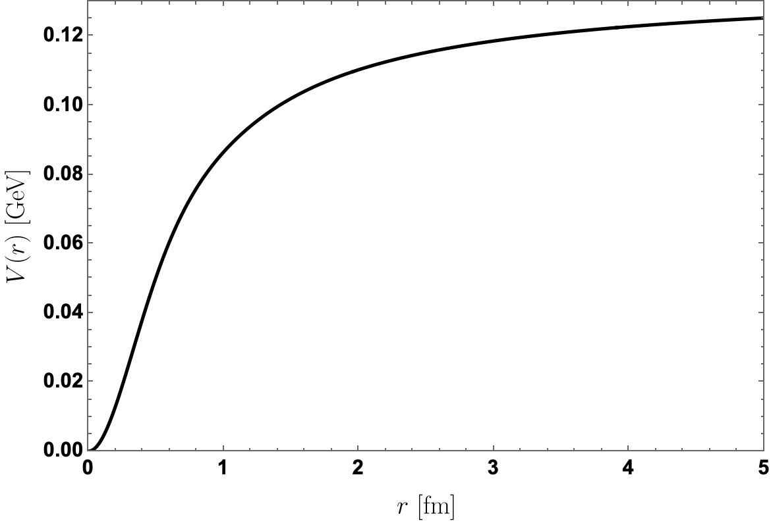
Heavy quarks in the background of the instanton ensemble
HQ propagator in the background of the instanton ensemble:
Large separation and limit (generating small expansion parameter ) allow writing (inverse) propagator in terms of single instanton propagators
The contribution to the heavy quark mass:
A similar calculations for particle – anti-particle
correlator results interaction potential
[D.Diakonov, V.Petrov, P.Pobylitsa 1989]
For further application to charmonium spectra see [U. Yakhshiev et al. 2018 ]

Slide 12
Heavy quark propagator in the presence of light quarks
QCD partition function:
Heavy quark propagator:
Use diluteness of instanton media
“heavy quark functional”
HQ functional in terms of single instanton average:

Slide 13
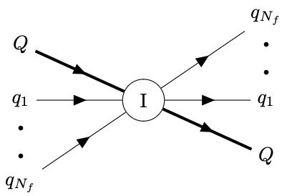
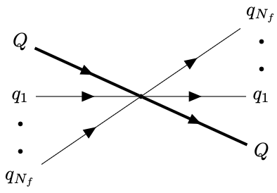
Heavy-light quark interaction
HQ propagator in the form of functional integration

Slide 14
Heavy-light quark interaction (1+1 case)
Single light and a heavy flavour case:
where
Immediate application is the calculation of weak decay constants
− in practical calculations one has to include $1/m_{Q}$ terms
− since heavy-light currents are non-conserved renormalization has to be performed
(due to $1/m_{Q}$ expansion the operator mixing pattern becomes more complex)
− match to QCD

Slide 15
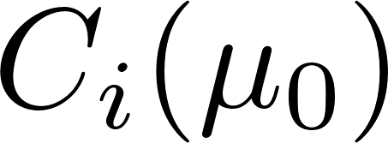
The application of 1+1 heavy-light interaction
$1/m_{Q}$ corrections to heavy quark field:
Renormalized vector (axial-vector) current:
- Wilson coefficients,
NLO currents in $1/m_{Q}$ expansion
The results for D and B meson decay constants in the range
[K. Hong et al, Phys.Rev.D 110 (2024)]

Slide 16
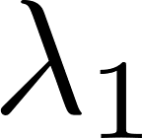
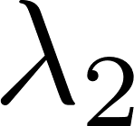
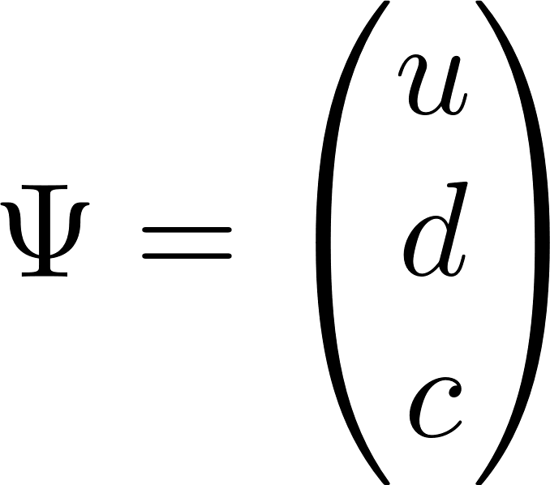
1+1 heavy-light interaction (outlook)
In $m_{Q}→∞$ limit pseudoscalar $\left(D, B\right)$ and vector $(D^{∗}, B^{∗})$ mesons’ masses are degenerate due to heavy quark spin-flavor symmetry
The degeneracy can be borken by considering $1/m_{Q}$ terms:
- residual mass, - mass shift due to kinetic operator, - the effect of chromo-magnetic interaction
! One should systematically account the contributions from quark gluon-operators
Collect all 4-quark interactions induced by instantons:
Can be used to study pion transitions between heavy meson states and the processes with light flavor change

Slide 17
Heavy-light quark interaction (2+1 case)
The content of two light and single heavy flavor quarks interaction:
1st term leads to heavy quark and light mesons interaction,
2nd term can be used to study the properties of axial and vector heavy mesons with iso-spin symmetry

Slide 18
Conclusion
We found instanton induced effective heavy-light quark interaction which can be represented as point interaction of single flavor heavy and $N_{f}$ flavor light quarks with a form factor $F\left(k\right)$attached each light quark leg. The interaction characterized by a coupling $g=M\left(0\right)ΔM_{Q}R^{4N_{f}}.$
The calculated decay constants for D and B mesons show good agreement with recent lattice QCD results and PDG average values.
Future outlook
Systematically include the contributions from quark-gluon operators to the definition of heavy meson mass;
Investigate pion transitions between heavy meson states and processes with light flavor change;
More generally, study heavy-light systems with iso-spin symmetry.
Thanks for the attention

